Slide 1


Aysha Fathima
245237

Slide 2
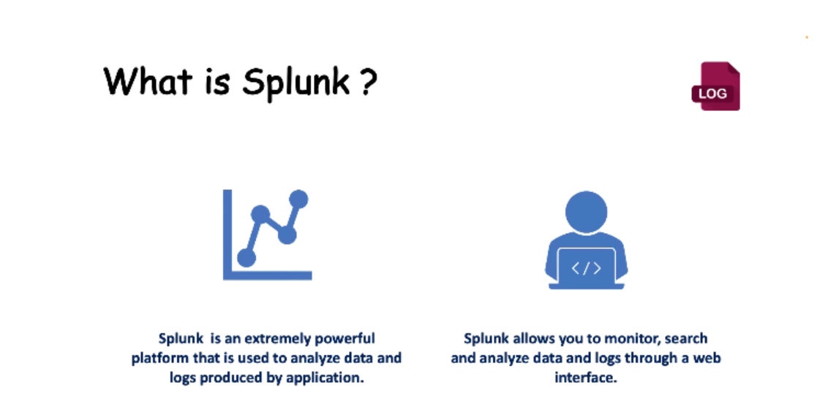


Slide 3
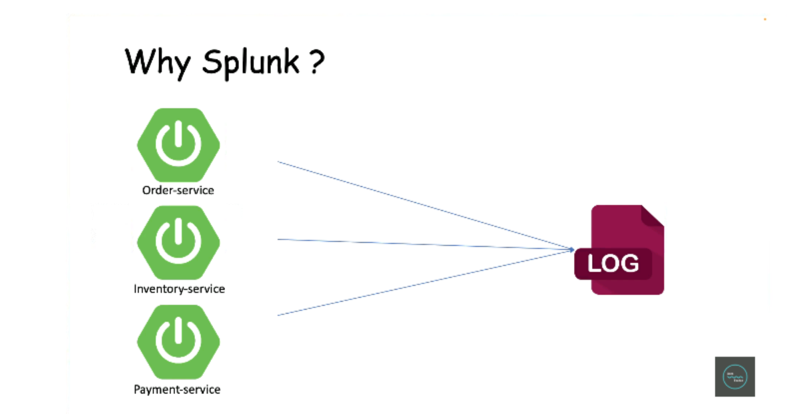

Slide 4
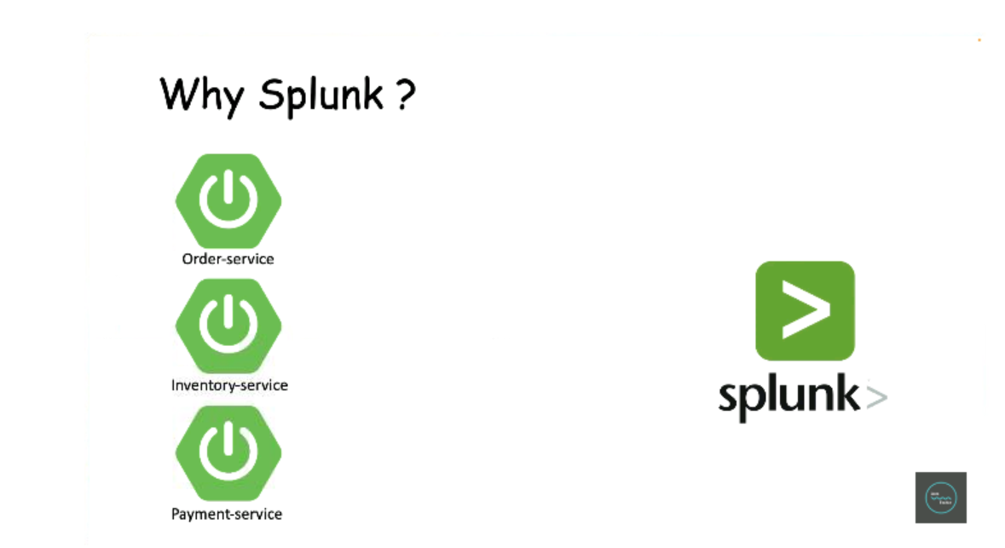

Slide 5
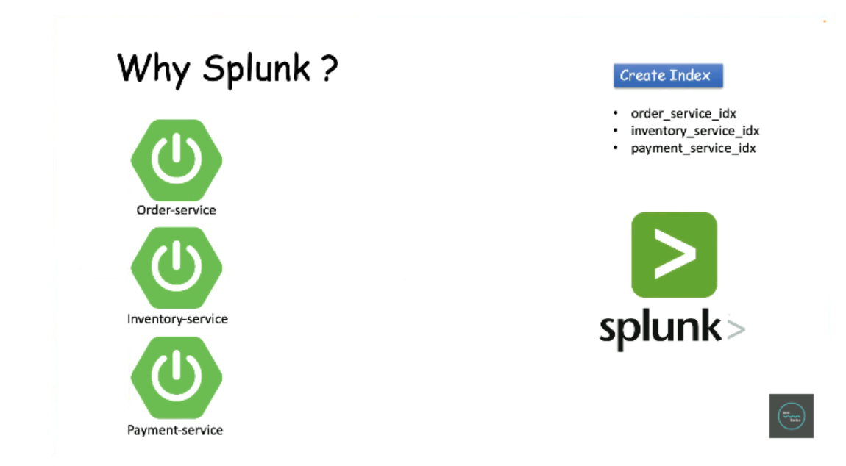

Slide 6
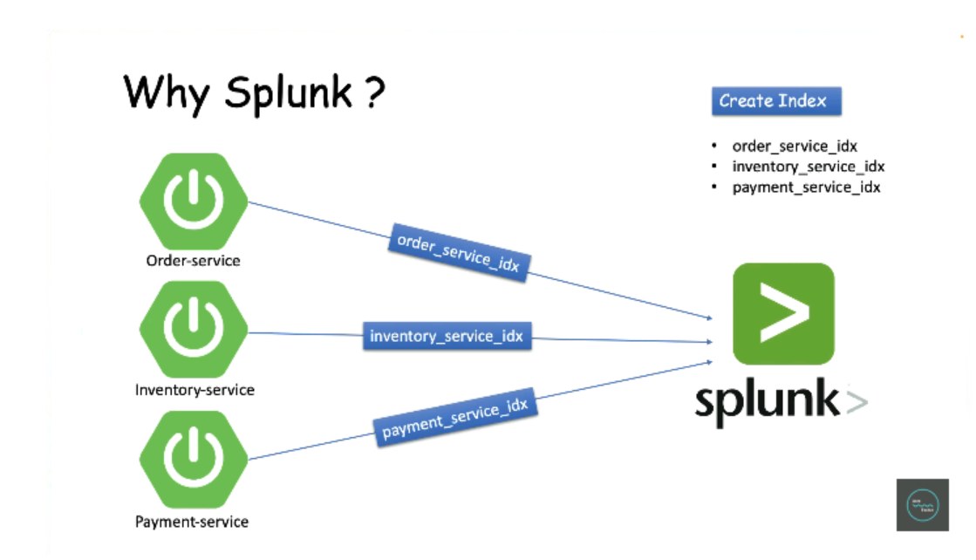

Slide 7
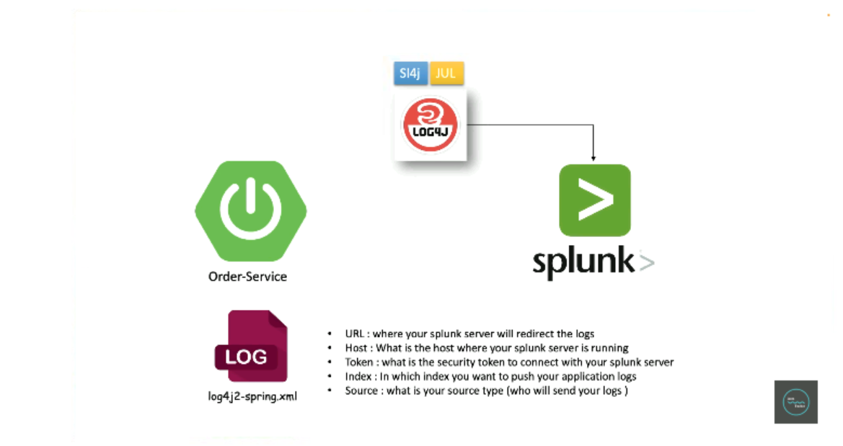

Slide 8
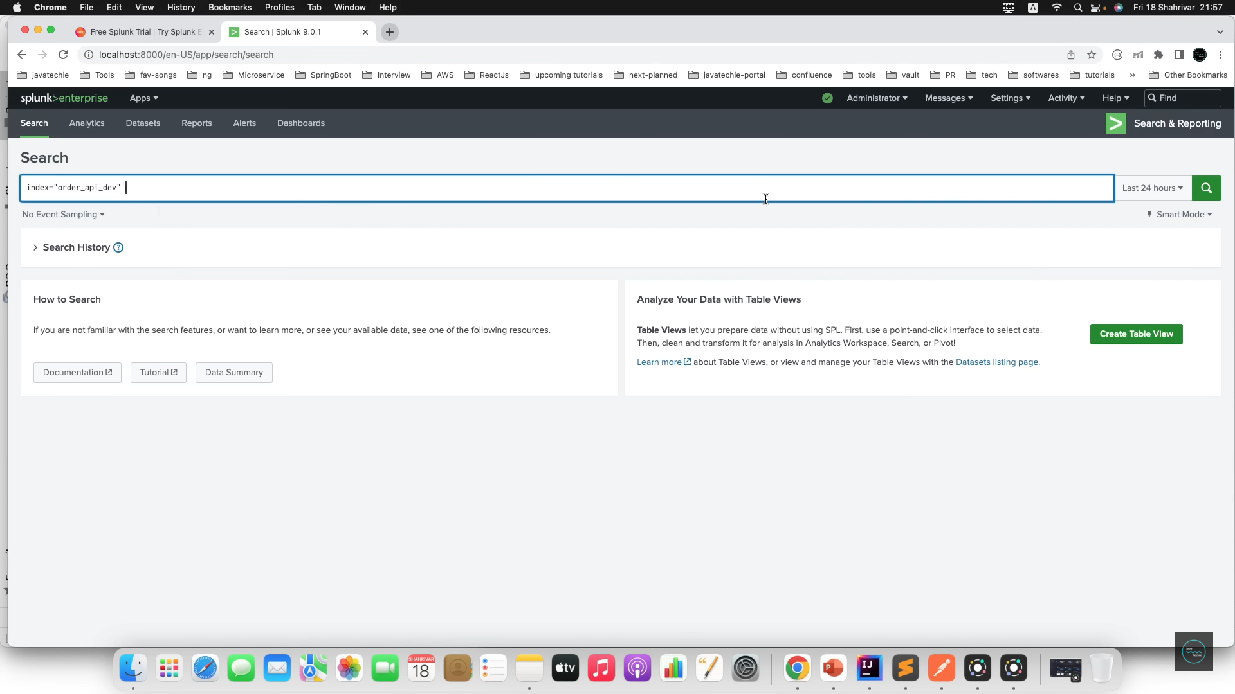

Slide 9
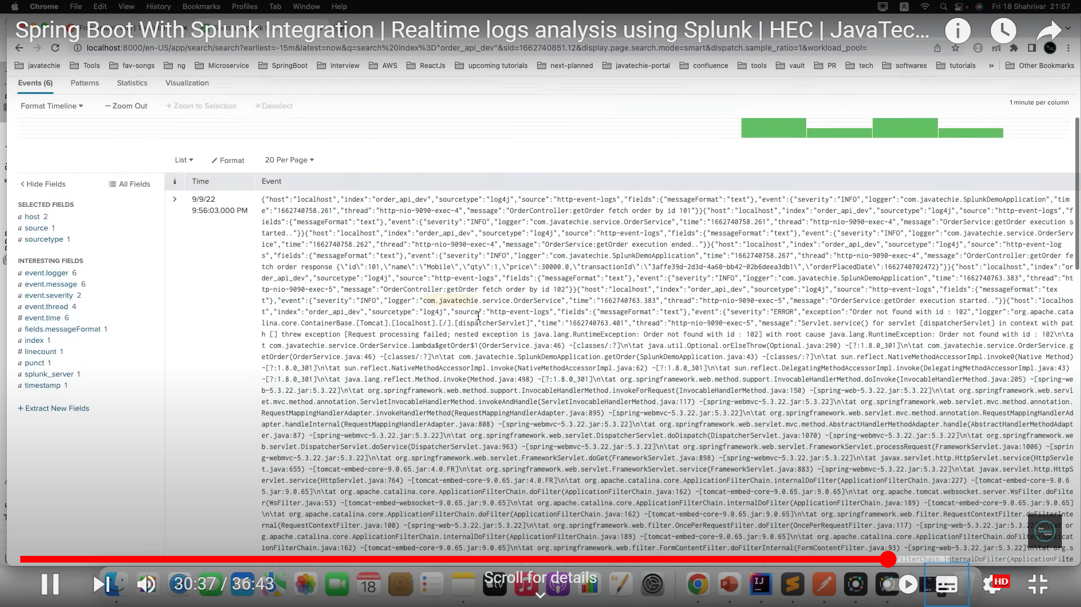

Slide 10
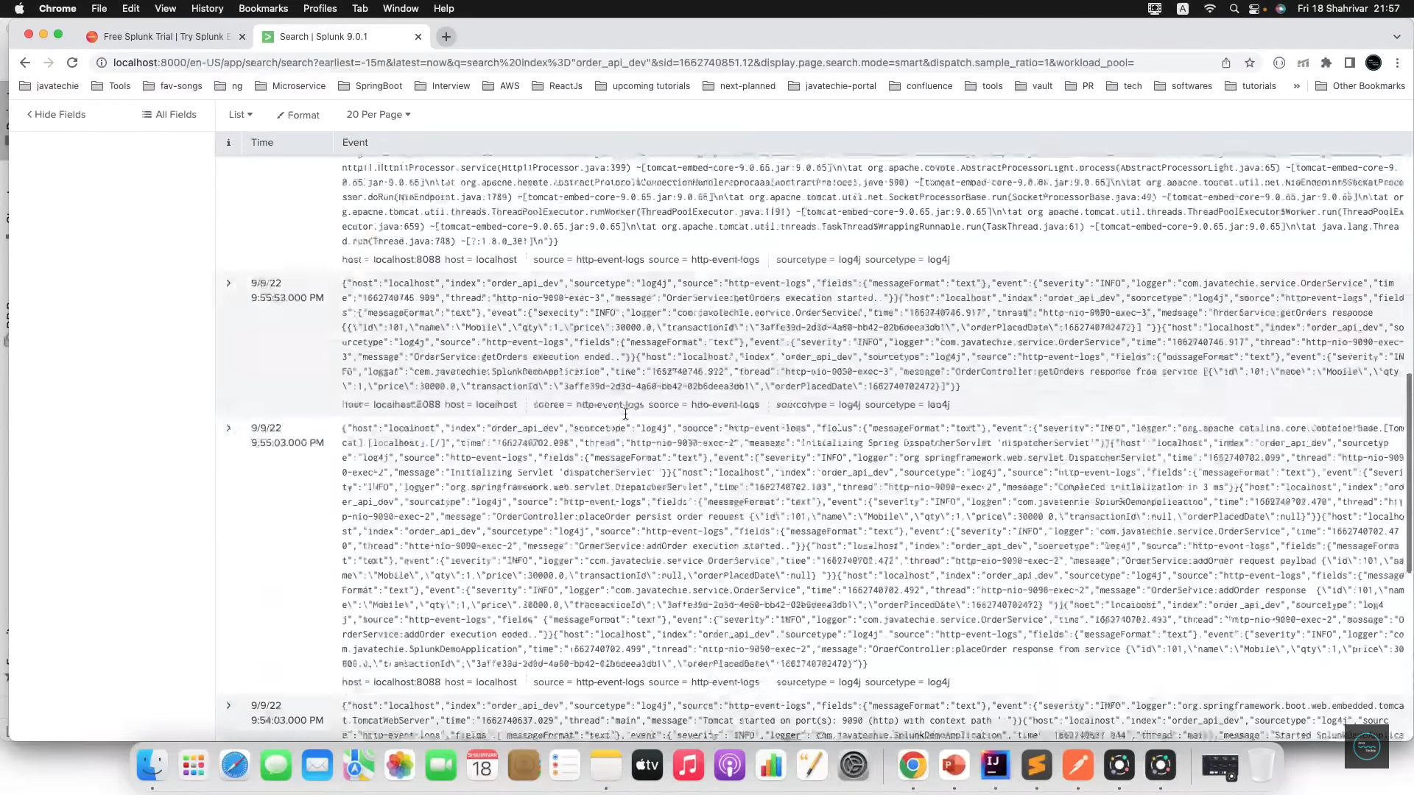

Slide 11
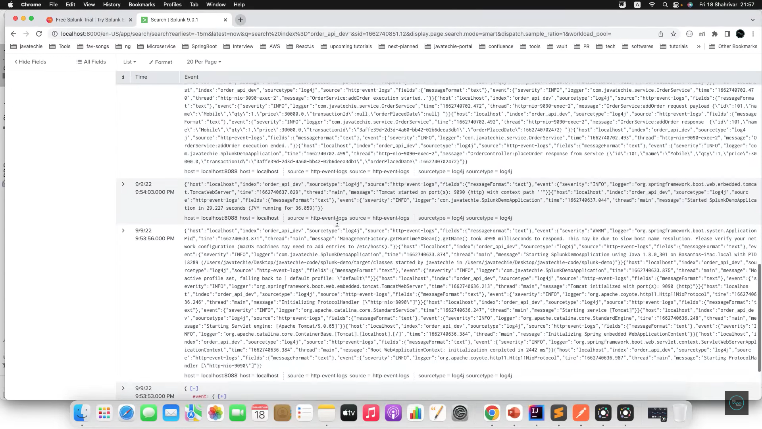

Slide 12
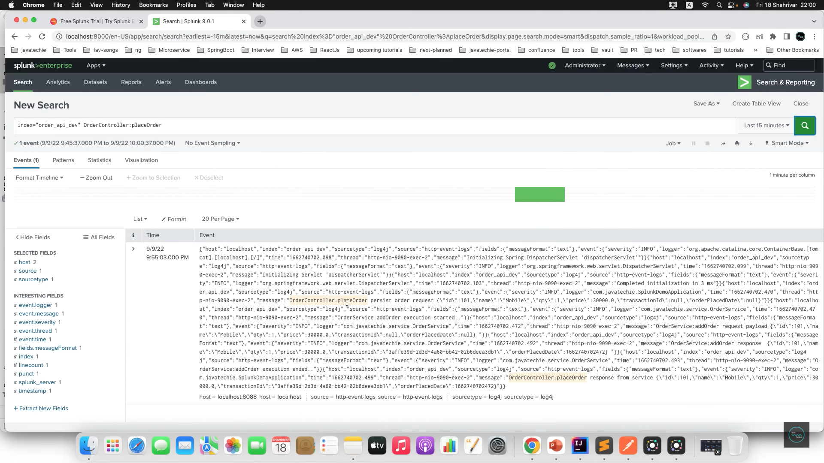

Slide 13
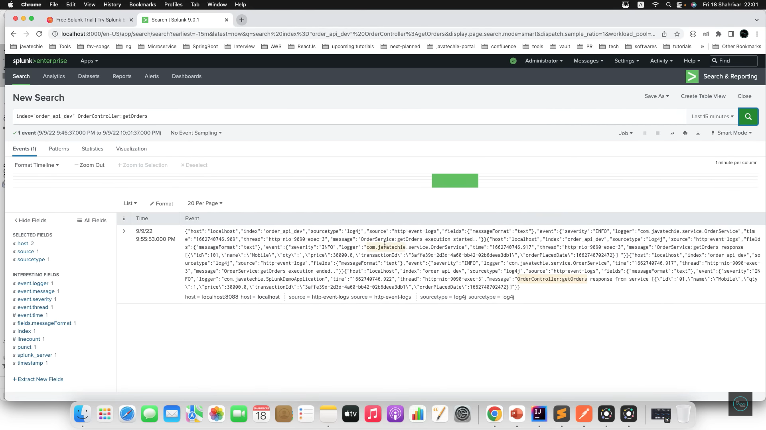

Slide 14
ADVANTAGES
Powerful data analysis: Splunk provides advanced search and analysis capabilities, allowing users to explore and gain insights from large volumes of data. It offers real-time monitoring, data visualization, and reporting features, making it effective for troubleshooting, security analysis, and business intelligence.
Centralized data platform: Splunk serves as a centralized platform for collecting and indexing data from various sources such as logs, metrics, and events. It provides a unified view of data, enabling organizations to gain a holistic understanding of their systems, applications, and infrastructure.

Slide 15
Scalability and performance: Splunk is designed to handle high volumes of data efficiently. It can scale horizontally by adding additional indexers to handle increased data ingestion and search load. Its distributed architecture ensures fast and responsive searches, even with large datasets.
Integration capabilities: Splunk offers a wide range of integrations with various data sources, third-party tools, and technologies. It can ingest data from diverse systems, including servers, applications, network devices, cloud platforms, and more. This flexibility allows organizations to leverage existing infrastructure and tools within their ecosystem.
Security and compliance: Splunk provides features for log analysis, anomaly detection, and incident response, making it valuable for security monitoring and compliance purposes. It can help detect and investigate security incidents, analyze threat patterns, and support regulatory compliance initiatives.

Slide 16
DISADVANTAGES
Cost: Splunk is a commercial product, and its licensing costs can be a significant factor, especially for organizations with large data volumes. The cost structure is based on data ingestion volume, and as the data grows, the licensing costs can increase significantly.
Learning curve: While Splunk offers powerful capabilities, it has a steep learning curve. Users need to become familiar with Splunk's search language, data models, and app development concepts to fully utilize its features. Training and expertise may be required to effectively use and administer Splunk.

Slide 17
Resource-intensive: Splunk can be resource-intensive in terms of hardware and infrastructure requirements. Organizations need to allocate sufficient storage, computing power, and network resources to handle the data ingestion, indexing, and searching processes effectively.
Complexity for large-scale deployments: Managing and scaling Splunk in large-scale deployments can be complex. Organizations may need to design and implement a distributed deployment architecture, manage cluster configurations, and optimize performance to handle the growing data volume efficiently.
Vendor lock-in: Choosing Splunk as a primary data analytics platform may lead to vendor lock-in, as transitioning to another platform can involve significant effort and cost.

Slide 18

REFERENCE
https://github.com/ayshafathim/Splunk-Springboot

Slide 19


